Slide 1

DevOps & Cloud Infrastructure SEIS 665 Infrastructure as Code
Jason Baker
Adjunct Instructor
Graduate Programs in Software
University of St. Thomas
St. Paul, MN

Slide 2
Agenda
Infrastructure as Code
Dynamic infrastructure platforms
Infrastructure definition tools
JSON/ YAML
AWS CloudFormation

Slide 3
Infrastructure as Code
Definition: An approach to infrastructure automation based on practices from software development.
Version control systems
Automated code testing
Continuous integration

Slide 4
Infrastructure as Code Principles
Systems can be easily reproduced like software builds.
A build creates artifacts that can be thrown away and recreated.
Systems are disposable.
Treat your servers like cattle, not pets.
Systems are consistent.
Same OS/distribution, packages, configuration.
Recognize that infrastructure will always need to change.
We use infrastructure definition and server configuration management tools to support these principles.
AWS Cloudstack, Terraform
Chef, Puppet, Ansible, Salt

Slide 5

Cattle vs. Pets
How do we know if we are treating our servers like pets?
Servers are named after things – Greek gods, planets, comic book characters – instead of function.
The server stays running for months or years.
The server is fixed and nursed back to health if it fails.
People are afraid to replace the server.
Beware of pet cows!

Slide 6
Infrastructure as Code Practices
Use definition files
Specify infrastructure elements and how they are configured
JSON, YAML, XML or Domain Specific Language (DSL)
Definition files and scripts offer a testable form of documentation.
Version everything
Source of truth for the desired state of infrastructure.
Traceability: history of changes and who made them.
Rollback: ability to revert infrastructure to a previous state.
Visibility: infrastructure configuration is clearly visible to everyone.
Continuously test systems
Automated infrastructure testing: every infrastructure change goes through a testing process.
Build infrastructure pipelines

Slide 7
Anti-Fragility
IT has always been focused on building reliable infrastructure.
Infrastructure as Code goes beyond traditional IT and makes infrastructure anti-fragile.
Exercise damages muscles, but also makes them stronger.
Preventing change in IT systems makes them weaker, while increasing and managing change makes them stronger.
Netflix Chaos Monkey & Chaos Kong

Slide 8
Chaos Engineering
Large-scale distributed systems are becoming increasingly complex.
Complex systems fail in unpredictable ways.
Chaos engineering seeks to identify weaknesses in complex systems.
Improper fallback settings when a system is unavailable.
Retry storms from improperly tuned timeouts.
Outages when downstream dependencies receive too much traffic.
Cascading failures when a single point of failure crashes.
Try to validate steady-state hypothesis through experimentation.
Site: http://principlesofchaos.org

Slide 10
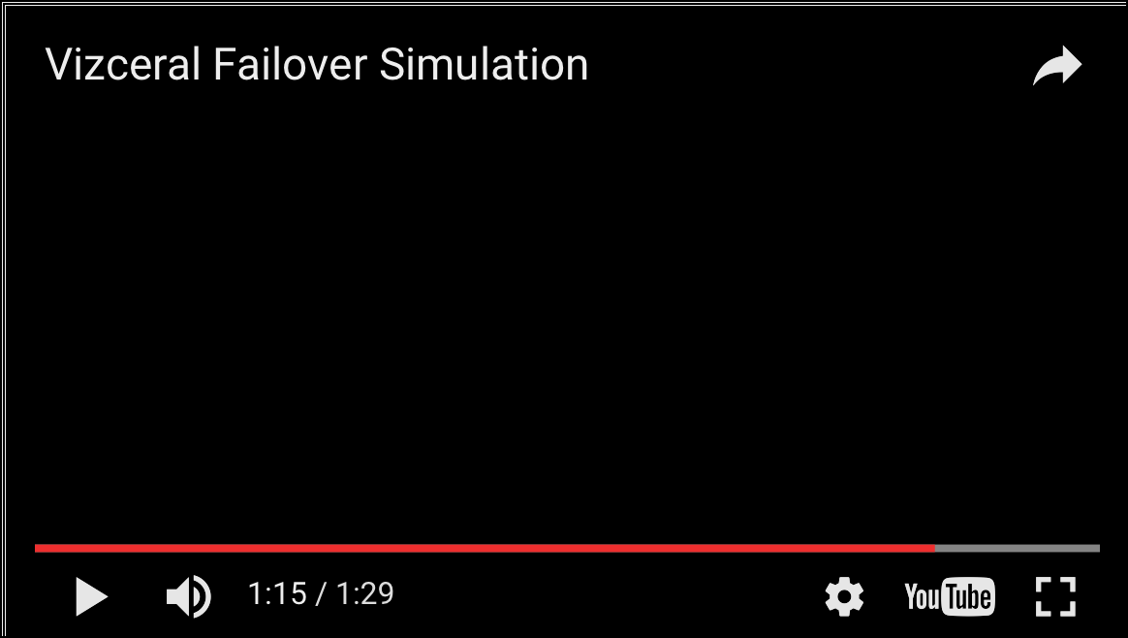
Intuition Engineering
A large cloud system is so complex a person can no longer understand it.

Slide 11
Building Infrastructure as Code
We need three capabilities to build and maintain dynamic infrastructure:
Dynamic infrastructure platform
Provides an environment in which to dynamically build infrastructure components.
Infrastructure definition tools
Provides a way to describe how to build components in the dynamic infrastructure platform.
Configuration management tools
Provides a way to manage the configuration of infrastructure components over time.

Slide 12
Dynamic Infrastructure Platform
A system that provides servers, storage, and networking infrastructure in a programmatic way.
Amazon Web Services
Microsoft Azure
Google Compute Engine
OpenStack
VMware vCloud
Requirements:
Access to an API
On-demand: create and destroy resources immediately.
Shouldn’t require requests to a provider to provision infrastructure.
Anti-pattern: Hand-cranked clouds

Slide 13
Infrastructure Definition Tools
Tool that allows people to specify what infrastructure component to create and how to configure it.
Leverages the API provided by the dynamic infrastructure platform to create the component.
Examples:
AWS Cloud Formation
Terraform
Openstack Heat

Slide 14
Infrastructure Definition Tool Characteristics
Idempotent: execute the same script multiple times without negatively impacting infrastructure.
Pre/post-checks: ability for tool to validate starting conditions and check for successful completion.
Visible failure: shouldn’t hide provisioning failures.
Parameterized: allows the reuse of infrastructure definitions for multiple use-cases (i.e., environments).

Slide 15
Using Infrastructure Definition Tools
Common practices:
Unattended execution: definition tools do not require human intervention to build infrastructure.
Configuration definition files: infrastructure definitions are stored in text files (JSON, YAML, DSL, etc.)
Externalized configuration: code that defines infrastructure is located outside the tool versus some sort of hidden internal configuration file.
VCS: infrastructure definition files are stored in version control systems.

Slide 16
Configuration Definition Files
Two ways to define infrastructure in configuration files:
Procedurally: describe the step-by-step process required to build infrastructure
“First do X, then do Y.”
Example: Shell script or application library using AWS API to create infrastructure (Python Boto3).
Declaratively: describe what the infrastructure should look like and let a tool build it.
“It should be Z.”
Sometimes called policy-based configuration.
Benefit: typically run idempotently – can apply configuration over-and-over again.

Slide 17
Procedural vs. Declarative

Slide 18
JavaScript Object Notation (JSON)
Very light-weight data-interchange format.
Easy for humans to read and machines to parse.
“self-describing”
Based on subset of JavaScript programming language, but it’s completely language independent.
Built on two structures:
Name/value pairs (object/hash)
Ordered lists (array)
Values can be:
String, number, object, array, true, false, null

Slide 19
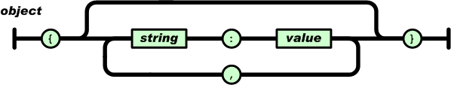
JSON Object Syntax
An Object:
Unordered set of name/value pairs
Object begins with { and ends with }
Each name followed by : (colon) and name pairs are separated by , (comma)
{ “name” : “Allie” }
{ “work” : “Target”, “home” : “Minneapolis” }

Slide 20
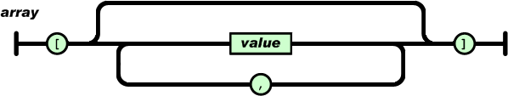
JSON Object Syntax
An Array:
Ordered collection of values
Array begins with [ and ends with ]
Values are separated by , (comma)
{ “employers” : [ “Target”, “Cargill”, “Medtronic” ] }
# nesting objects/arrays
{
“employer” : { “name” : “United Health”,
“employees” : [ “John”, “Miguel”, “Heather” ]
}
}

Slide 21
YAML
YAML Ain’t Markup Language (YAML)
Human friendly data serialization standard for all programming languages.
Benefits:
Very simple to use.
Human readable.
Information can easily be translated to multiple programming language types.

Slide 22
YAML Rules
Basic rules:
YAML files should end with .yaml (or .yml) extension
YAML is case sensitive.
YAML does not allow tabs, use space instead.
Indentation (spaces) have meaning!
Data begins with 3 dashes “---” (optional)
See http://yaml.org for specific requirements.

Slide 23
YAML Data Types
Scalars:
Integer: 25
String: “25”
Float: 25.0
Boolean: Yes
Sequences (arrays):
- Cat
- Dog
- Goldfish
fish: [Cat, Dog, Goldfish]
Mappings (hashes):
animal : pets

Slide 24
JSON vs. YAML Example
{ “breakfast_menu”:
{ “food”:
[
{ “name”:”Belgian Waffles”,
“price”:”$6.99”,
“description”:”Our wonderful Belgian Waffles”,
“calories”:650
}
]
}
}
---
breakfast_menu:
food:
- name: Belgian Waffles
price: "$6.99"
description: Our wonderful Belgian Waffles
calories: 650

Slide 25

AWS CloudFormation
AWS infrastructure definition tool used for automating the deployment of cloud infrastructure.
Several AWS services (Elastic Beanstalk, ECS, etc.) use CloudFormation for infrastructure provisioning.
CloudFormation uses a template to describe what resources to configure on AWS.
Template is written in JSON or YAML format.
Supports good Infrastructure as Code practices.
Store in version control
Ability to test
Repeatable
A set of configured cloud resources is called a stack.

Slide 26
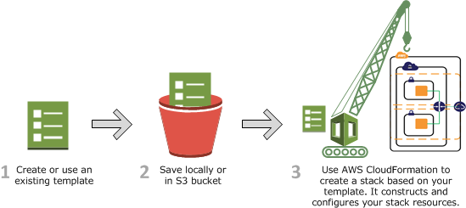
How CloudFormation Works
CloudFormation uses template definition to make API calls to AWS.
User’s permissions determines what resources it can create.
Process:
1. Create a CloudFormation Template (JSON) in CloudFormation Designer or a text editor.
2. Save the template locally or in an S3 bucket.
3. Create a stack by specifying the template and providing any required input parameters using AWS console, API, or CLI.
4. CloudFormation provisions resources and reports back when the stack is created.

Slide 27
CloudFormation Template
{
“AWSTemplateFormationVersion” : “version date”,
“Description” : “JSON string”,
“Metadata” : {
template metadata
},
“Parameters” : {
set of parameters
},
“Mappings” : {
set of mappings
},
“Conditions” : {
set of conditions
},
“Resources” : {
set of resources
},
“Outputs” : {
set of outputs
}
}

Slide 28
Parameters section
Templates allow the user to supply input parameters when launching a stack.
Parameter logical names must be unique.
Logical name definition followed by a series of parameter properties.
Types: String, Number, List, or AWS-specific type
Maximum of 60 parameters allowed in a template
Input parameters are referenced within a template using the “Ref” function.
"Parameters" : {
"ParameterLogicalID" : {
"Type" : "DataType",
"ParameterProperty" : "value“
}
}

Slide 29
Parameters section
Useful parameter properties (not a complete list):
AllowedValues: an array containing list of values allowed for the parameter.
Default: the value used for the property if no value is specified.
Description: a string describing the parameter.
MaxLength/MinLength/MaxValue/MinValue: set a constraint on the input value
NoEcho: hide the parameter value in any output logs (useful for passwords).

Slide 30
Parameters section
“Parameters” {
“InstanceTypeParameter” : {
“Type” : “String”,
“Default” : “t2.micro”,
“AllowedValues” : [“t2.micro”, “t2.small”, “t2.medium”],
“Description” : “Enter the instance type (t2.micro, t2.small, or t2.medium).”
}
}
”Resources” : {
“Ec2Instance” : {
“Type” : “AWS::EC2::Instance”,
“Properties” : {
“InstanceType” : { “Ref” : “InstanceTypeParameter” },
“ImageId” : “ami-398de234”
}
}
}

Slide 31
Outputs section
The optional outputs section declares values that CloudFormation will return when the stack is created.
Example: return the name of an S3 bucket after CloudFormation creates it.
Maximum of 60 outputs allowed in a template.
Available via the describe stacks API call.
Value of an output can be a literal, parameter reference, pseudo parameter, mapping value, or intrinsic function.
It’s possible to set a condition on the output using the “Condition” parameter.
"Outputs" : {
"Logical ID" : {
"Description" : "Information about the value",
"Value" : "Value to return"
}
}

Slide 32
Outputs section
"Outputs" : {
"BackupLoadBalancerDNSName" : {
"Description": "The DNSName of the backup load balancer",
"Value" : { "Fn::GetAtt" : [ "BackupLoadBalancer", "DNSName" ]},
"Condition" : "CreateProdResources"
},
"InstanceID" : {
"Description": "The Instance ID",
"Value" : { "Ref" : "EC2Instance" }
}
}

Slide 33
Intrinsic Functions
CloudFormation supports several built-in functions to help you build stacks.
Conditional (if-then-else)
Lookup
Retrieve data
Only usable in certain parts of the template – mainly in resource properties.
"Properties" : {
"MyLBDNSName" : {
"Fn::GetAtt" : [ "MyLoadBalancer", "DNSName" ]
}
}

Slide 34
Intrinsic Functions
Fn::Base64
Converts test string to Base64 representation.
Typically used for passing userdata to an EC2 instance.
{ “Fn::Base64” : “sudo yum update -y” }
Fn:FindInMap
Performs a value lookup in a hash/dictionary object.
"Fn::FindInMap" : [ "MapName", "TopLevelKey", "SecondLevelKey"]
Fn:GetAtt
Returns the value of an attribute from a resource in the template.
"Fn::GetAtt" : [ "MyLoadBalancer" , "DNSName" ]
Fn:GetAZs
Returns an array that lists Availability Zones for a specified region (or whatever region the stack is launching in).
{“Fn::GetAZs” : “us-east-1”}
{ "Fn::GetAZs" : { "Ref" : "AWS::Region" } }

Slide 35
Intrinsic Functions
Fn:Join
Concatenates a set of values into a single value with an optional delimiter.
"Fn::Join" : [ ":", [ "a", "b", "c" ] ]
Returns: “a:b:c”
Fn:Select
Returns a single object from a list of objects.
{ "Fn::Select" : [ "1", [ "apples", "grapes", "oranges", "mangoes" ] ] }
Returns: “grapes”
Ref
Returns the value of the specified parameter or resource.
"Ref" : "logicalName”
Condition Functions
Used within conditions sections to conditionally create resources.
"Fn::Equals" : ["value_1", "value_2"]
"Fn::If": [condition_name, value_if_true, value_if_false]
{”Fn::If” : [“production”, “m3.xlarge”, “t2.micro”] }

Slide 36
Pseudo Parameters
Pseudo Parameters are predefined parameters provided by CloudFormation.
List of pseudo parameters:
AWS::AccountId
returns AWS account ID in which stack is created
AWS::NotificationARNs
returns list of AWS Resource Names for stack
AWS::NoValue
acts like a NOOP and removes the property identifier
AWS::Region
returns a string representing the AWS region for the stack
AWS::StackId
returns ID of the stack
AWS:StackName
returns the name of the stack

Slide 37
Mappings section
Template mappings allow the user to define keys that map to corresponding sets of named values.
Commonly used for setting values based on different conditions, such as regions.
Example: Set a value to an AMI ID based on the region the stack is launching into.
The “FindInMap” function is used in the template to find a matching value based on a key.
"Mappings" : {
"Mapping01" : {
"Key01" : {
"Name" : "Value01“
},
"Key02" : {
"Name" : "Value02“
},
}
}

Slide 38
Mappings section
"Mappings" : {
"RegionMap" : {
"us-east-1" : { "32" : "ami-6411e20d", "64" : "ami-7a11e213" },
"us-west-1" : { "32" : "ami-c9c7978c", "64" : "ami-cfc7978a" },
"eu-west-1" : { "32" : "ami-37c2f643", "64" : "ami-31c2f645" },
"ap-southeast-1" : { "32" : "ami-66f28c34", "64" : "ami-60f28c32" },
"ap-northeast-1" : { "32" : "ami-9c03a89d", "64" : "ami-a003a8a1" }
}
},
"Resources" : {
"myEC2Instance" : {
"Type" : "AWS::EC2::Instance",
"Properties" : {
"ImageId" : { "Fn::FindInMap" : [ "RegionMap", { "Ref" : "AWS::Region" }, "32"]},
"InstanceType" : "m1.small"
}
}
}
If AWS::Region is us-east-1, ImageId is set to ami-6411e20d.

Slide 39
Conditions section
Template conditions control the creation of resources or the definition of properties.
Conditions are defined by the template author and applied to resources.
A condition must evaluate to true in order for the resources to get built.

Slide 40
Conditions section
“Parameters” : {
“EnvType” : {
“Description” : “Environment type.”,
“Default” : “dev”,
“Type” : “String”,
“AllowedValues” : [“prod”, “dev”],
“ConstraintDescription” : “Must specify prod or dev.”
}
},
“Conditions” : {
“CreateProdResources” : {“Fn::Equals” : [{“Ref” : “EnvType”}, “prod”]}
},
“MountPoint” : {
“Type” : “AWS::EC2:VolumeAttachment”,
“Condition” : “CreateProdResources”,
“Properties” : {
“InstanceId” : { “Ref” : “EC2Instance” },
“VolumeId” : { “Ref” : “NewVolume” },
“Device” : “/dev/sdh”
}
}
If EnvType input parameter = prod, create the MountPoint resource.

Slide 41
Resources section
Describes the AWS resource to be built in the stack.
IAM policies, VPCs, Subnets, Security Groups, EC2 instances, Elastic Load Balancers, RDS databases, S3 buckets, etc.
The only required section.
"Resources" : {
"Logical ID" : {
"Type" : "Resource type",
"Properties" : {
Set of properties
}
}
}
DependsOn attribute allows you to specify that a resource must wait for CloudFormation to create another resource first.
"DependsOn" : [ String, ... ]

Slide 42
Resources section
Multiple ways to define properties:
"Properties" : {
"String" : "one-string-value",
"Number" : "123",
"LiteralList" : [ "first-value", "second-value" ],
"Boolean" : "true",
"ReferenceForOneValue" : { "Ref" : "MyLogicalResourceName" } ,
"FunctionResultWithFunctionParams" : {
"Fn::Join" : [ "%", [ "Key=", { "Ref" : "MyParameter" } ] ] }
}

Slide 43
Resources section
"Resources" : {
“web1" : {
"Type" : "AWS::EC2::Instance",
"Properties" : {
"UserData" : {
"Fn::Base64" : {
"Fn::Join" : [ "", [ "Queue=", { "Ref" : "MyQueue" } ] ]
} },
"AvailabilityZone" : "us-east-1a",
"ImageId" : "ami-20b65349"
}
},
"MyQueue" : {
"Type" : "AWS::SQS::Queue",
"Properties" : {
"Tags": [
{
"Key": "Project",
"Value": "Fido"
}
]
}
}
}

Slide 44
Nested Stacks
CloudFormation stacks can be used as resources in other stacks.
Useful for making reusable templates and segmenting resources.
Launching a template with nested stacks will launch multiple sub-stacks.
Nested stack templates must be stored in an S3 bucket.
Deleting launching stack will delete all substacks.

Slide 45
Configuration state
CloudFormation does not maintain any configuration state locally.
It determines current state of stack anytime updates are made.
This allows multiple developers to work on a stack simultaneously without having to share configuration state.
Terraform stores current configuration state locally and all developers must share information.

Slide 46
CloudFormation Best Practices
Version templates in a source control system.
Don’t build a template from scratch.
Read sample templates or use AWS CloudFormation Designer as a starting point.
Reuse templates as much as possible.
Don’t nest stacks more than one level.
Use parameters to set the environment, region, instance names & sizes, etc.
Try not to hardcode values into resource definitions.
Remember to add tags to all resources.
Consider using a snapshot to backup resources that may be changed during a stack update.
Example: changing engine type of an RDS instance.
Alternatively: set a stack policy to protect resources from updates.

Slide 47
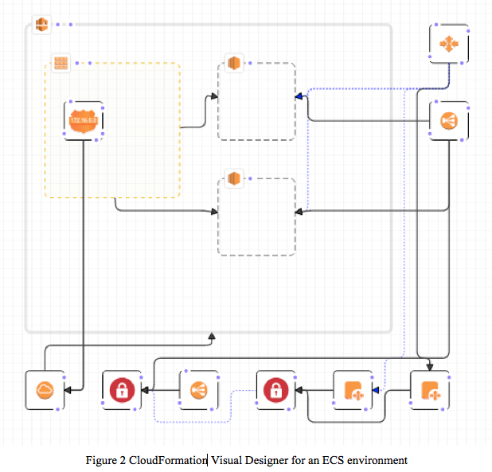
CloudFormation Designer
A graphical tool to visualize and edit CloudFormation templates.
Easy way to start new designs or edit specific resources in complex templates.
JSON template editor supports auto-complete using Ctrl-Space.

Slide 48

CloudFormation Hands-on
Launch a simple stack to create a new S3 bucket.
https://s3.amazonaws.com/seis665/s3bucket.json
Review CloudFormation template
Launch a new stack using the template
View the newly created S3 bucket.
Note the automatically generated bucket name.
Modify simple S3 stack to output the bucket website address:
"Outputs": {
”BucketUrl" : {
"Value": {"Fn::GetAtt": ["seis665", "WebsiteURL"]},
"Description": "S3 bucket website address."
}
}

Slide 49
CloudFormation Hands-on
Launch a single EC2 instance into a VPC
VPC: 10.0.0.0/16
PublicSubnet: 10.0.1.0/24
Webserver instance
ImageID: ami-3ea13f29
Security Group:
Allow port 22, 80 from anywhere
Review CloudFormation template
Launch a new stack using the template
View the newly created instance
https://s3.amazonaws.com/seis665/BasicWebserverInVPC.json

Slide 50
Additional Resources
AWS CloudFormation Best Practices guide
https://docs.aws.amazon.com/AWSCloudFormation/latest/UserGuide/best-practices.html
CloudFormation documentation
https://aws.amazon.com/documentation/cloudformation/
CloudFormation Resource Types
http://docs.aws.amazon.com/AWSCloudFormation/latest/UserGuide/aws-template-resource-type-ref.html

